Slide 1
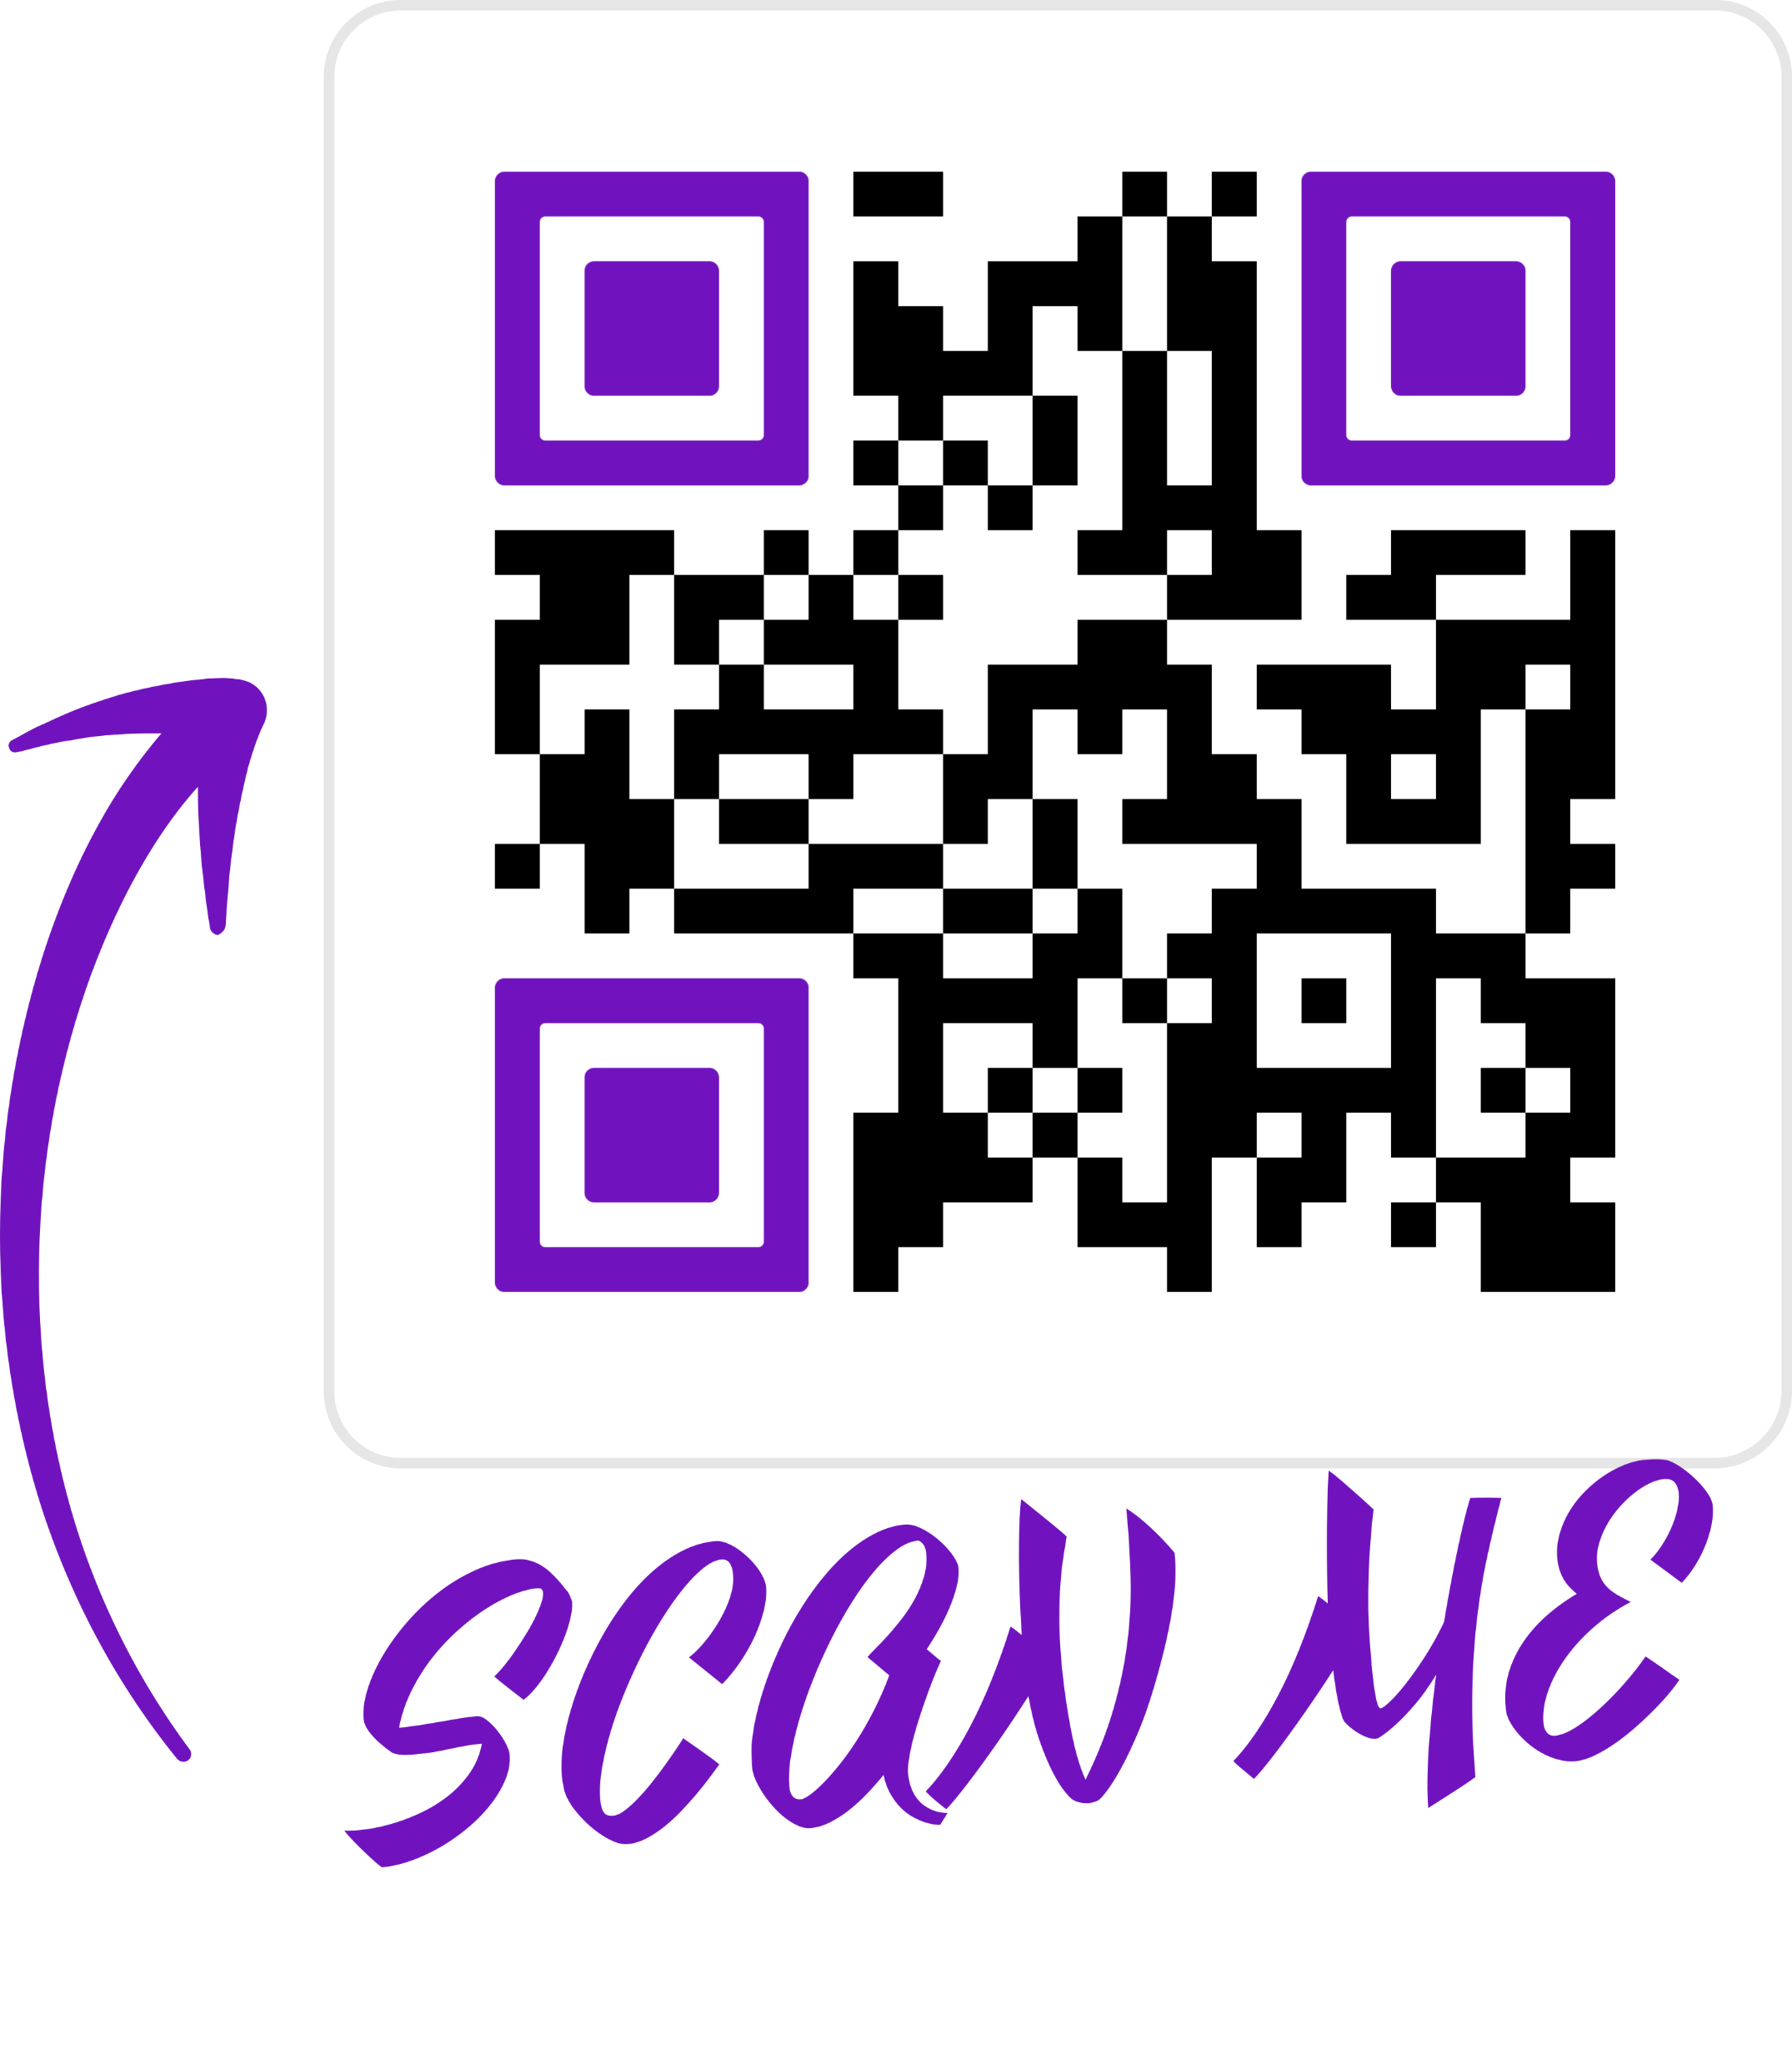
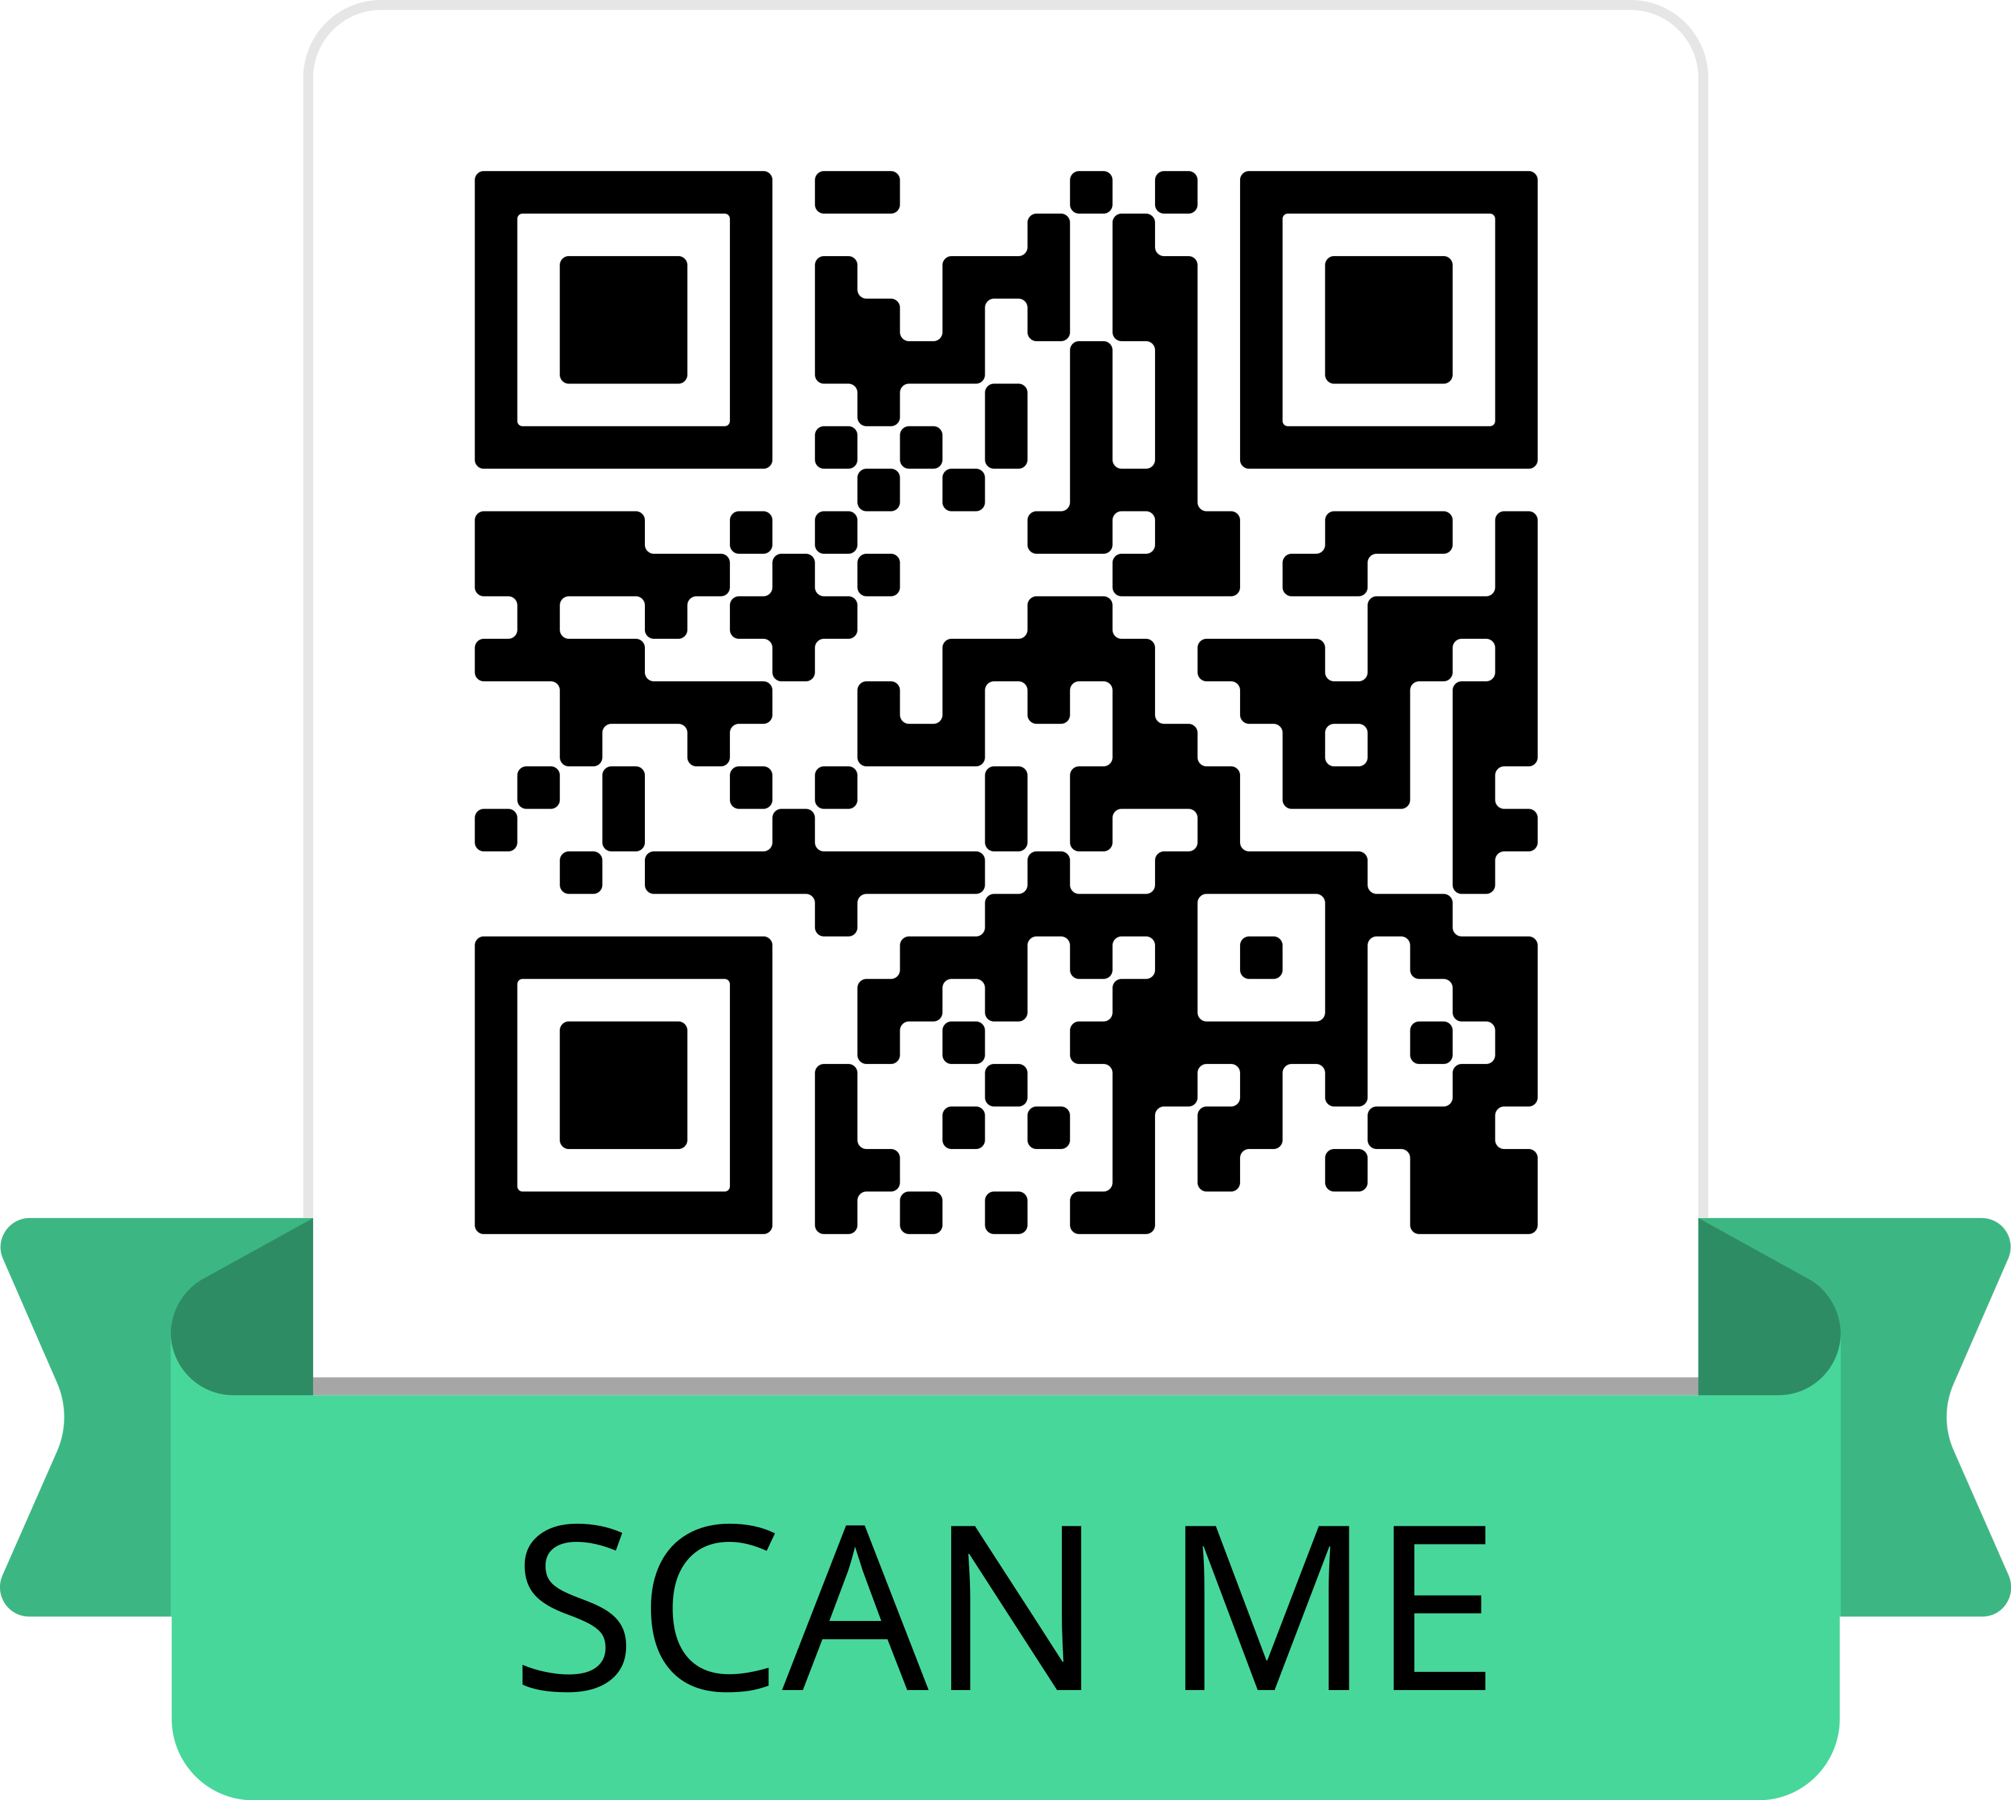
Looking for help?
Use this QR code for our Newcomer Packet
For more on GRAPEVINE, our meeting in print:

