Slide 1
Public Information Committee 2021 Annual Report
PI Chairperson
Bill M.
PI Committee Members
Kimmie H.
Joe E.
Tania C.
Michael W.
Victoria K.

Slide 2
Public Information Committee 2021 Summary
We want to thank Area 17 Panel 71 Officers for allowing us to serve on the PI Committee.
This year presented many challenges on how we would effectively carry the message of Alcoholics Anonymous and keep the community at large properly informed about AA.
Thanks to AA’s worldwide resources, the dedicated members of this committee and their ideas, we believe we were able to remain relevant during current times and remain as effective as possible in serving our committee’s 2021 goals and thus fulfilling our purpose.

Slide 3
Public Information Committee Goals and Objectives 2021
Understanding Anonymity Workshop: Conducted April 2021
Read from the PI Workbook regarding Anonymity to attendees
Past and Present Delegates participated on a panel
Floor opened for questions and comments from attendees
Statewide PSAs: Work commenced on May 2021
Recorded a 30-second PSA (tailored to Area 17) for Broadcasting Companies
Developed a Written Request Letter to send with the recorded PSA
Compiled a list of local broadcasting companies and emailed a copy of our PSA Package
Created a PI Facebook page and website to serve the online community
Implemented various online campaigns to inform the public about AA in Area 17.
Develop Wallet Cards: December 2021
Design Wallet Cards. Consideration to each Intergroup/Central Office contact information
Printed at Aiea Copy
Developed Formal Letter to accompany the wallet card
Mailed 100 each wallet cards to each Intergroup/Central Office (5) for dissemination

Slide 4
Public Information Committee Understanding Anonymity in the Digital Age
The workshop started off with the serenity prayer followed by the reading from the Public Information Workbook pages 25 thru 31 which provide various views on the topic of Anonymity. There is a wealth of information about the importance of Anonymity especially as the fellowship evolves into the digital age. I have come to believe in the preservation of our history, at the same time navigating into our future to remain relevant and effective regarding our primary purpose. The workbook passages provide a good platform or a reminder about the importance of Anonymity as we move forward.
Each Delegate than spoke on their experience about the topic. Bob H. started and really set the tone as each delegate followed and focused on the topic. Laura H. past Delegate Panel 66 who also served on the Public Information Committee prior to the COVID-19 outbreak gave a detailed history of AA and its experiences with Anonymity and it developments. Keith D. past Delegate Panel 67 who is well-versed in technology and spoke about where AA is regarding technology. He posed several good questions for us to think about. 1) Are we concern about anonymity or our own personal privacy? He stated they are not the same. 2) Are we considering who we are trying to reach in terms of those who are suffering? How and what resources they use to find AA? Are we relevant in terms of effectively communicating with those who suffer from alcoholism in this current day and age? These questions got me thinking as well. Shane S. Delegate Panel 70 and current Chair of the Conference PI Committee finished the presentation on the importance of Anonymity considerations and how the fellowship will continue to be effective carrying the message of AA. His presentation was highlighted by talking about the preliminary outcomes of a recent audit of AA’s internal and external communications (now finalized at the time of this writing). He stated that AA needs to do much more to remain relevant if AA is to remain effective to include the use or technology. We must be smarter and better at it.
The presentation was open for discussion and questions for the panelist and closed with the responsibility statement. In closing, it was insightful and refreshing to hear valuable information from the panelist and all those who participated. As the current PI Chairperson, it sparked much thought and excitement about Area 17 PI efforts and how we have the responsibility to shape future efforts.

Slide 5
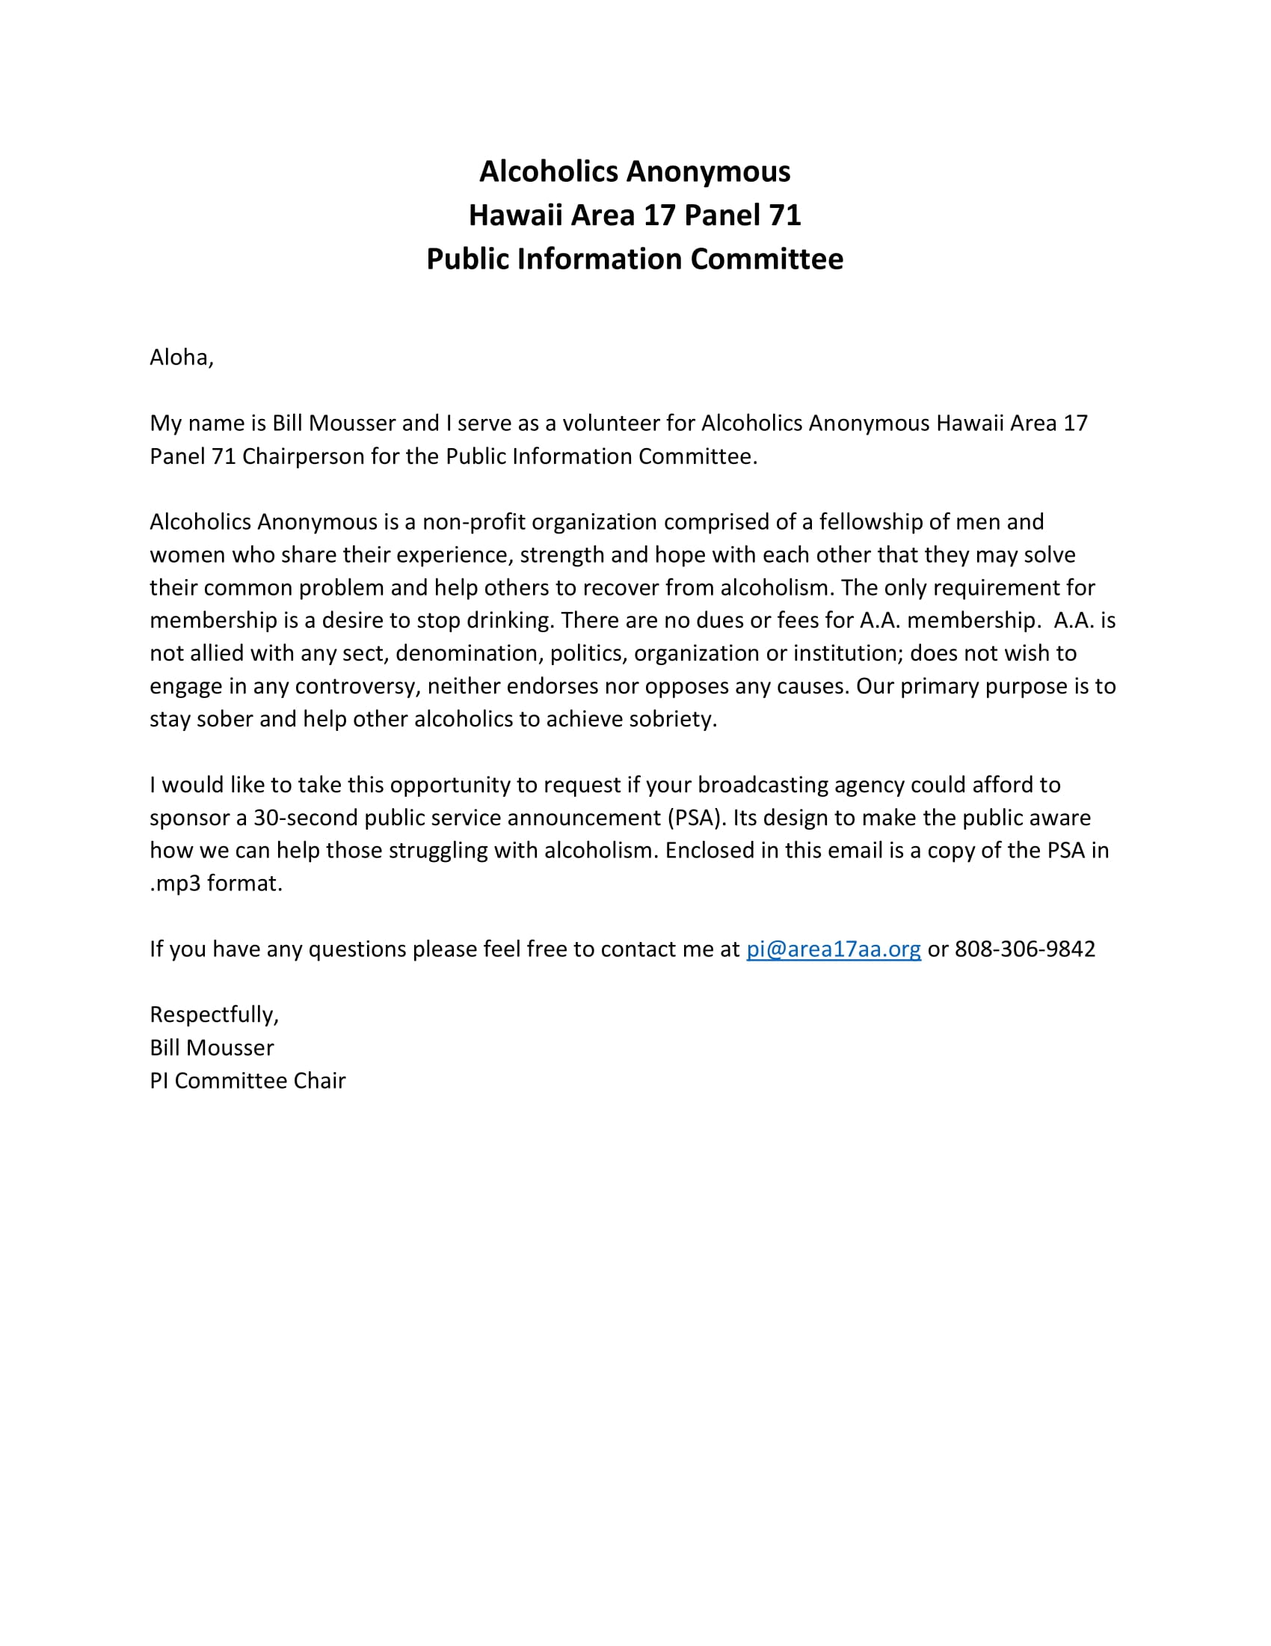
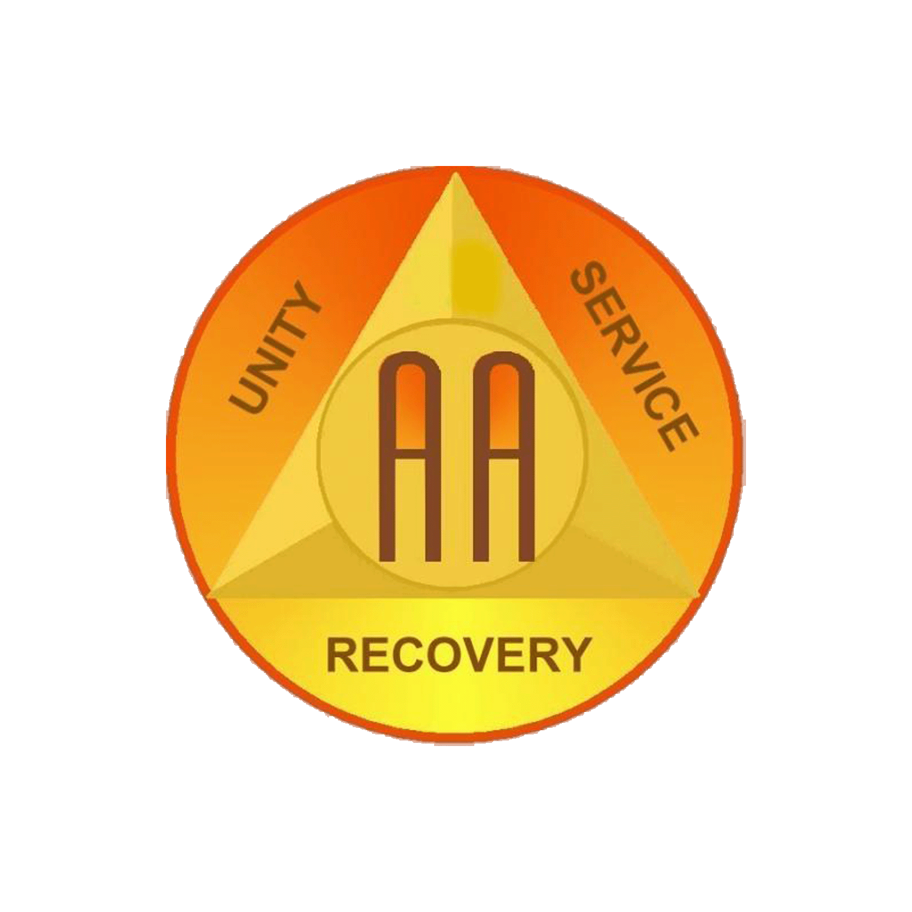
Public Information Committee PSA to Broadcasting Agencies
A PSA (click on the logo) was created and tailored for Hawaii Area to include contact information for Oahu Central Office allowing the potential listener to contact Alcoholics Anonymous. The committee compiled a list of local broadcasting agencies and contact information. In May we sent the Request Letter and PSA to 9 out of 12 agencies with 4 committing to include the PSA in their broadcasting rotation. We want to thank KDNI Radio, KKNE 940 AM, 96.7 FM Radio and Pacific Media Group for their kind contributions.
One of our greatest resources we were introduce to in 2021 was the Technology in AA Online Community (TIAA) where PI and CPC members from around the globe discuss ways to continue PI/CPC efforts using various online platforms. TIAA was very instrumental in helping us develop systems to conduct our work.
As a result, the committee created a Facebook page to use as a tool for PI campaigns and post upcoming events.
https://www.facebook.com/Public-Information-Area-17-105301001578615 We also created a website to use as an additional tool to keep the public informed https://area17pi.org/ Most importantly, these tools help us track information about PI campaigns and their effectiveness.

Slide 6
Public Information Committee Facebook PSA Campaign (Pilot)
In 2021, the PI Committee commenced on several FB campaigns starting with this pilot announcement to experiment and test new systems. This campaign was linked to Oahu Central Office website. The campaign included a homemade video with Area 17 Intergroup contact information coupled with an AA approved audio. We were able to track demographics, people reached, page engagement, and link clicks to mention a few. The campaign was active for 20 days (about 3 weeks).

Slide 7
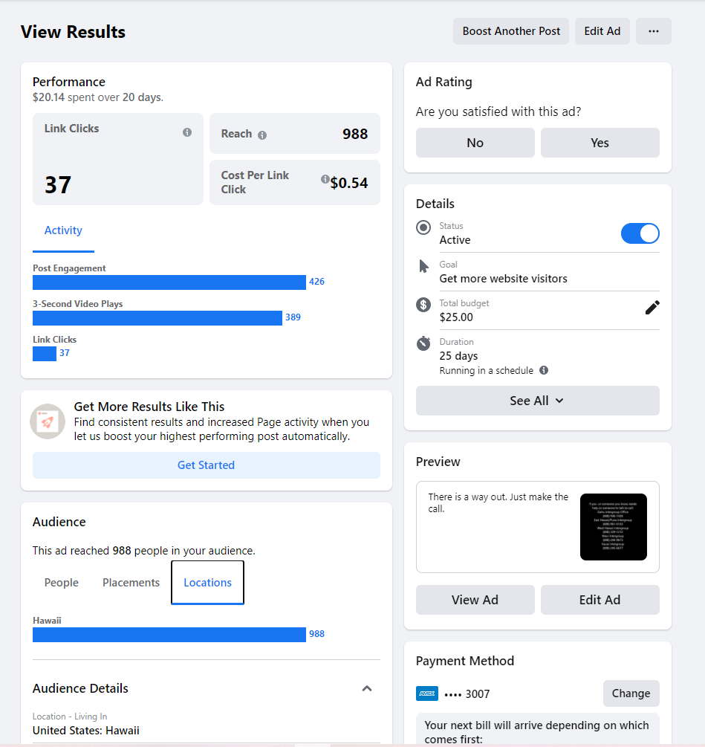
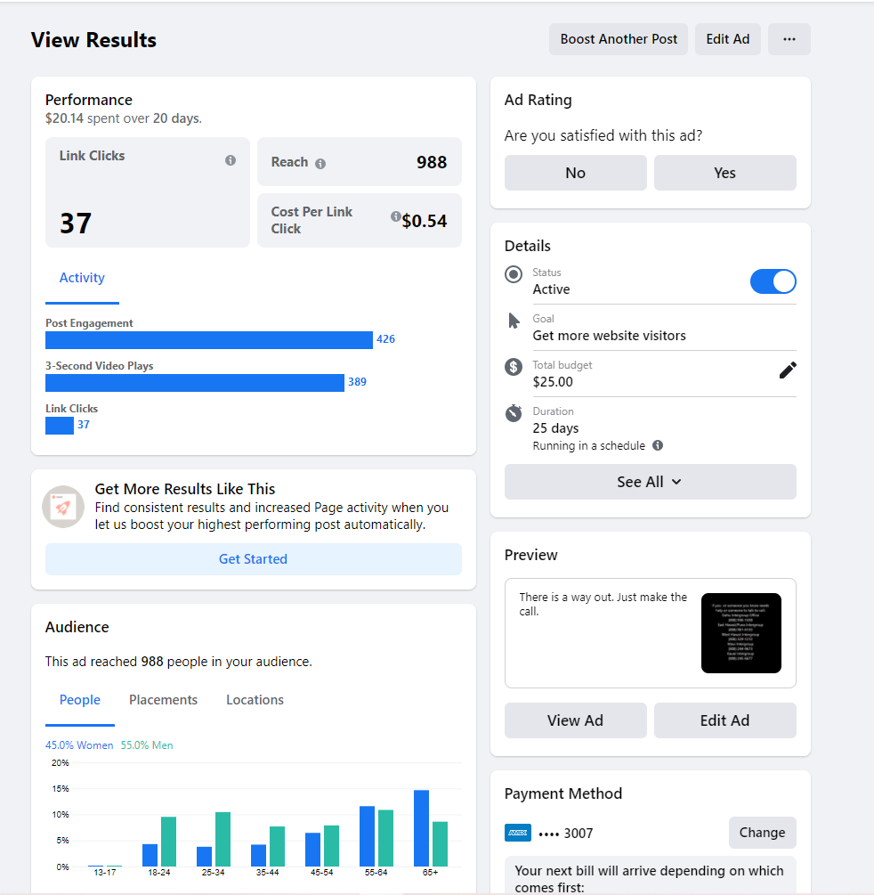
Public Information Committee Facebook PSA Campaign (Pilot) Results
Here is a sample of the information we were able to collect based on the pilot. The only data we were not able to collect is if visitors were members of AA or not and if anyone called Oahu Central Office as a result of this campaign.
Ad/Campaign
Target Audience
People reached
Post Engagement
Link Clicks (OIG website)
Demographics
Cost

Slide 8
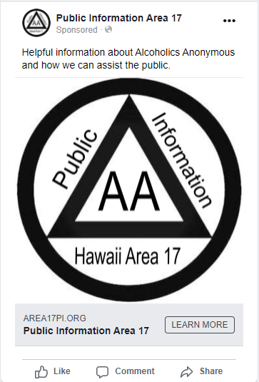
Public Information Committee Facebook PSA Post Campaign 1
Our first Post Campaign commence on 11/8/21 and ceased on 12/13/21 (36 days). This campaign was linked to our PI website and targeted towards the home page.
https://area17pi.org/

Slide 9
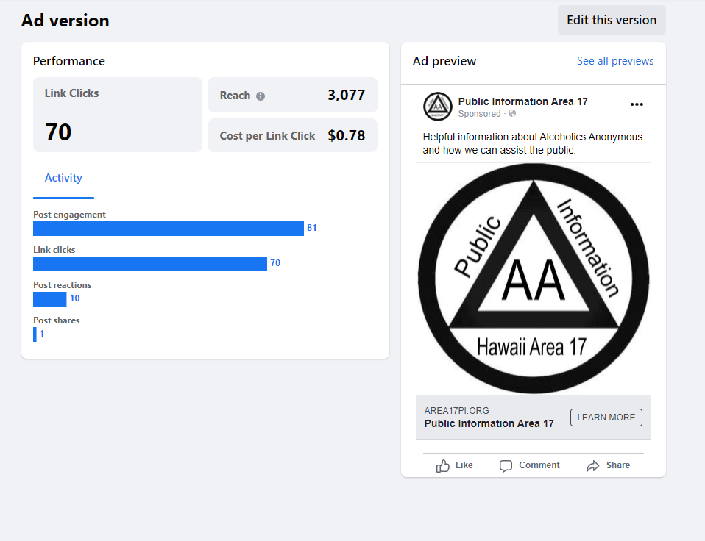
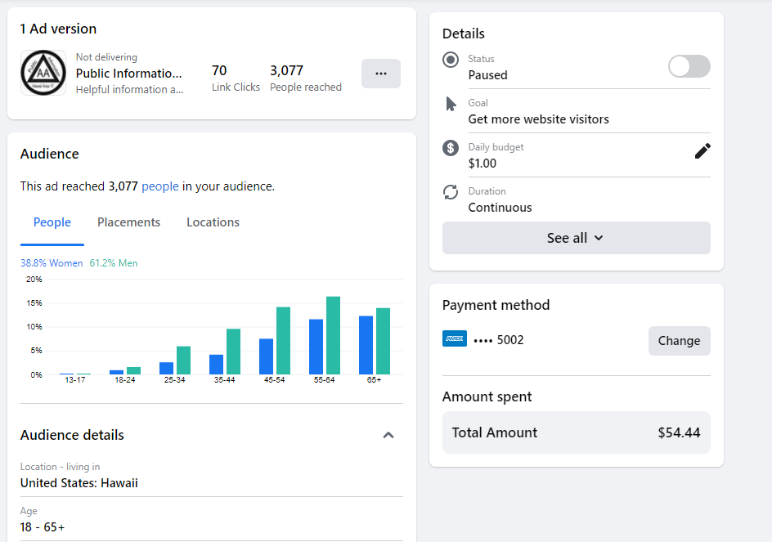
Public Information Committee Facebook PSA Campaign 1
The campaign reached 3,077 FB/IG viewers, approximately 3% engaged with approximately 86% of those engaged visited the PI website. The demographics indicate older adults particularly men engaged with the campaign. Other data like post reaction and post shares were available too.

Slide 10
Public Information Committee Facebook PSA Video Campaign 2
Campaign 2 commence on 11/2/21 and ceased on 12/26/21 (34 days). This campaign was linked to our PI website targeted towards our Cooperating with Our Community page https://area17pi.org/are-you-a-professional/. (Click on the video)

Slide 11
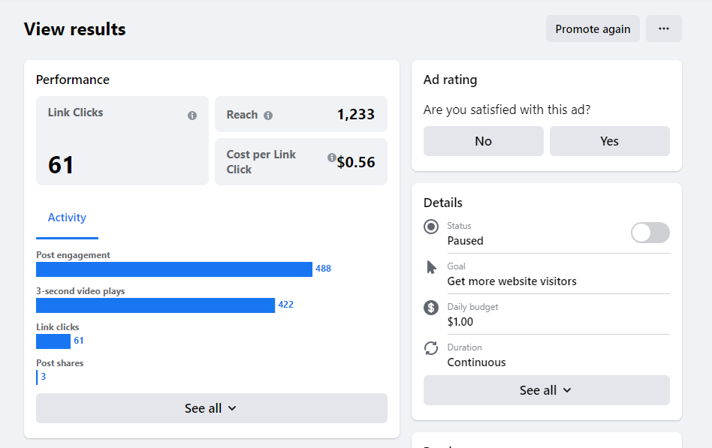
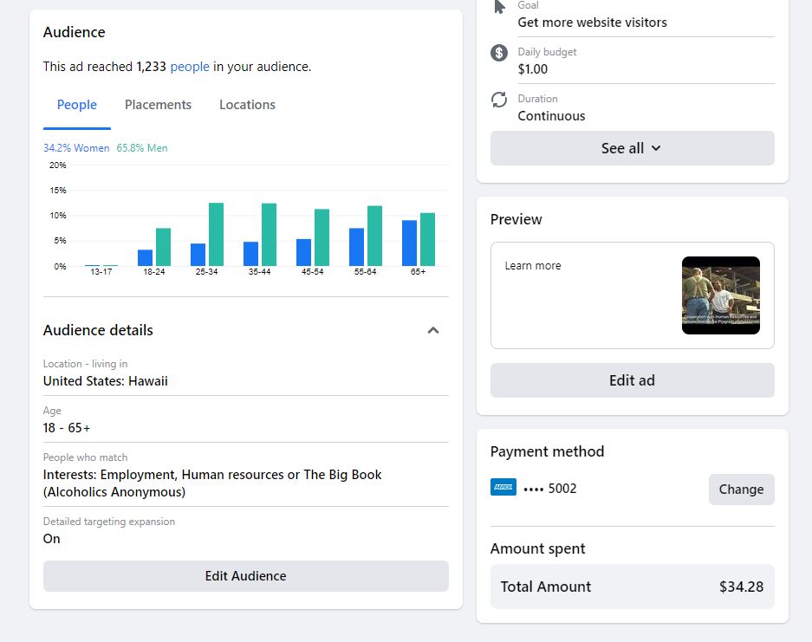
Public Information Committee Facebook PSA Campaign 2
The campaign reached 1,233 FB/IG viewers, approximately 39.6% engaged, 86.5% viewed the campaign video for more than 3 seconds and approximately 12.5% of those engaged visited the targeted webpage. The demographics indicate slightly older adults particularly men engaged with the campaign. Other data like post reaction and post shares were available too.

Slide 12
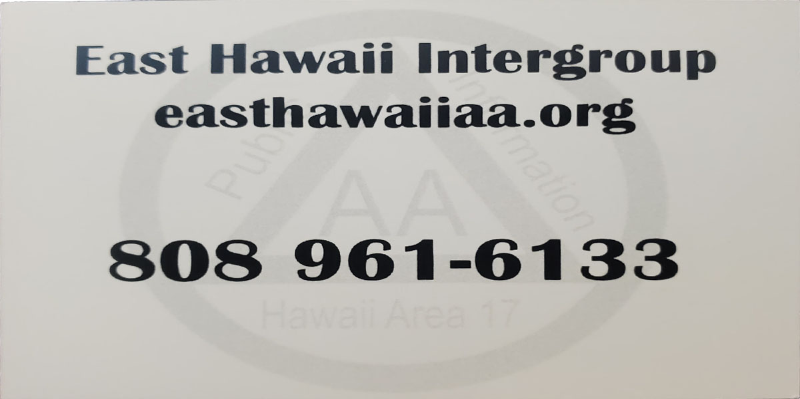
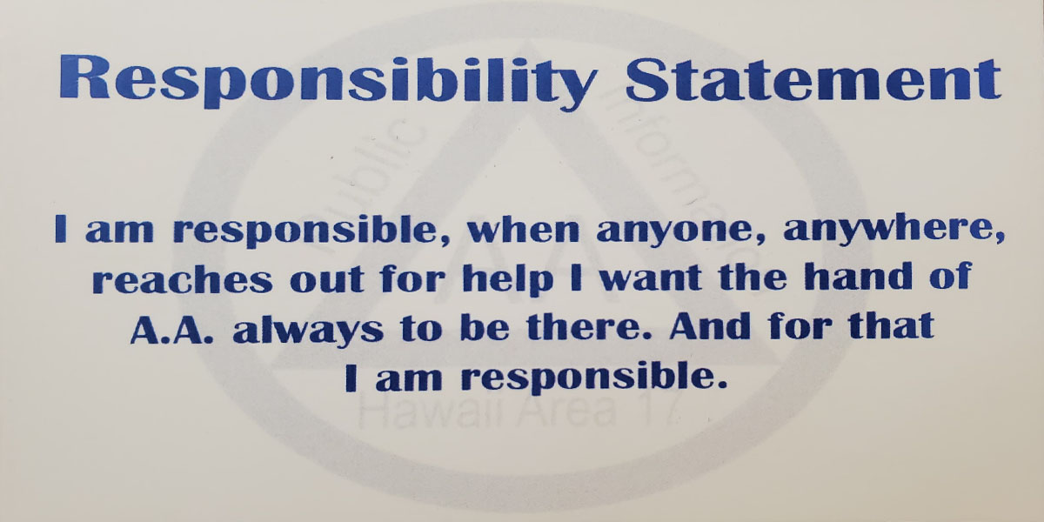
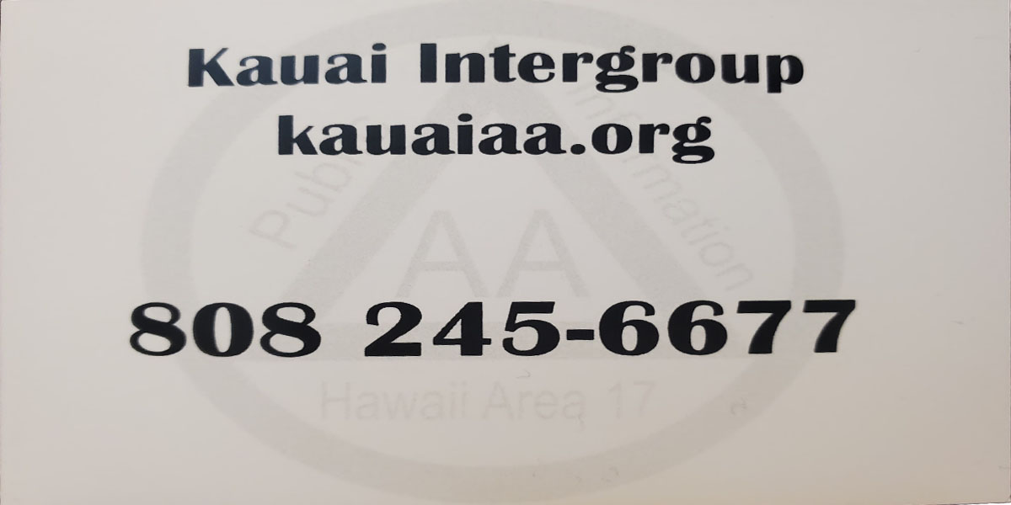
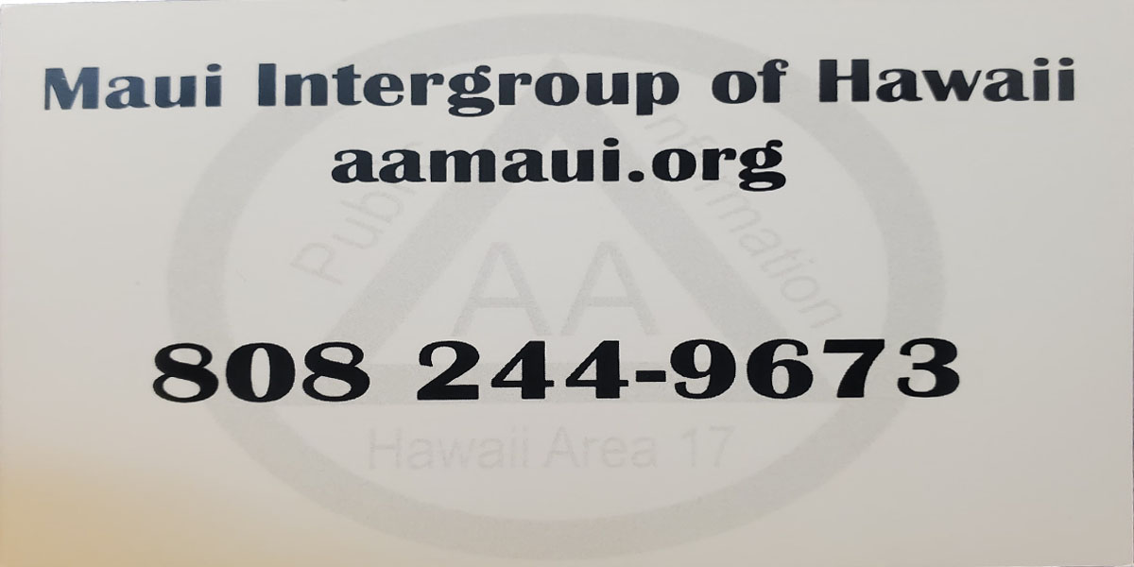
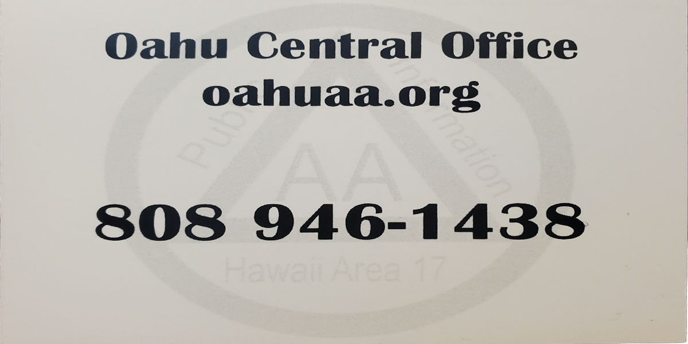
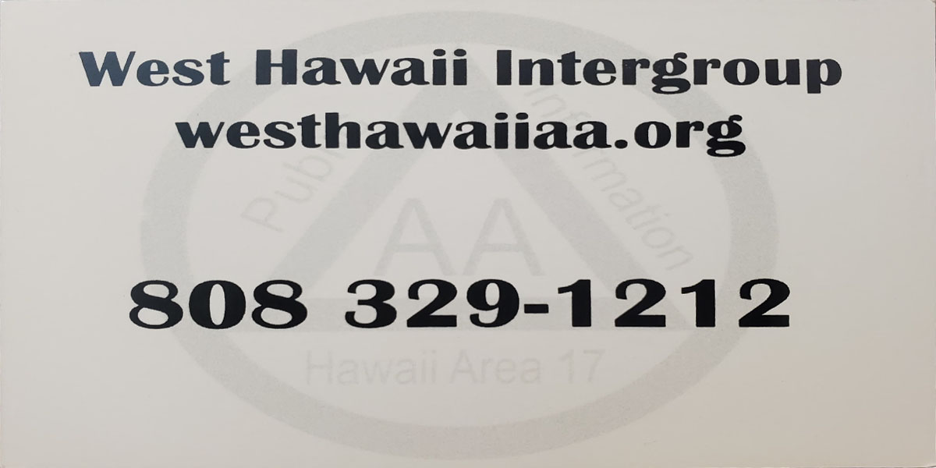
Public Information Committee Wallet Size Cards
Wallet size cards were created and distributed to each Central/Intergroup Office in December 2021.
100 cards for each office the Responsibility Statement and their contact information was mailed out and accompanied by an appreciation letter.

Slide 13
Public Information Committee Summary
In summary, our committee is thankful for the opportunity to serve Hawaii Area 17. Our plans for 2022 will be discussed before or at the January 2022 Area Assembly.

